Slide 1

CAPSTONE PROJECT PYTORCH

Slide 2
AGENDA
INTRODUCTION
DATABASE
MODEL ARCHITECTURE
MODEL FINE-TUNING
INSIGHTS AND LEARNINGS

Slide 3

INTRODUCTION

Slide 4
INTRODUCTION
THE PROJECT AIMS TO BUILD AN IMAGE CLASSIFICATION MODEL USING CONVOLUTIONAL NEURAL NETWORKS (CNN).
TO CLASSIFY HUMAN ACTIVITIES INTO 15 DIFFERENT CATEGORIES.
THE MODEL WILL BE TRAINED TO RECOGNIZE ACTIVITIES SUCH AS CALLING, CLAPPING, CYCLING, DANCING, DRINKING, EATING, FIGHTING, HUGGING, LAUGHING, LISTENING TO MUSIC, RUNNING, SITTING, SLEEPING, TEXTING, AND USING A LAPTOP.
THE GOAL IS TO ACCURATELY CLASSIFY THE ACTIVITY DEPICTED IN EACH IMAGE, LEVERAGING THE POWERFUL FEATURE EXTRACTION CAPABILITIES OF CNNS.

Slide 5



DATABASE
Human Action Recognition

Slide 6
DATABASE
TRAIN- CONTAINS ALL THE IMAGES THAT ARE TO BE USED FOR TRAINING YOUR MODEL. IN THIS FOLDER, YOU WILL FIND 15 FOLDERS NAMELY CALLING, CLAPPING, CYCLING, DANCING, DRINKING, EATING, FIGHTING, HUGGING, LAUGHING, LISTENING_TO_MUSIC, RUNNING, SITTING, SLEEPING, TEXTING, USING_LAPTOP, WHICH CONTAIN THE IMAGES OF THE RESPECTIVE HUMAN ACTIVITIES.
TEST - CONTAINS 5400 IMAGES OF HUMAN ACTIVITIES. FOR THESE IMAGES, YOU ARE REQUIRED TO MAKE PREDICTIONS AS THE RESPECTIVE CLASS NAMES - CALLING, CLAPPING, CYCLING, DANCING, DRINKING, EATING, FIGHTING, HUGGING, LAUGHING, LISTENING_TO_MUSIC, RUNNING, SITTING, SLEEPING, TEXTING, USING_LAPTOP.

Slide 7

MODEL ARCHITECTURE

Slide 8
MODEL ARCHITECTURE
DATA PREPARATION
THE DATA WAS PREPROCESSED BY LOADING FROM GOOGLE DRIVE, CONVERTING LABELS INTO NUMERIC FORM USING LABEL ENCODING.
THE DATA WAS BALANCED BY SELECTING AN EQUAL NUMBER OF IMAGES PER CLASS.
THE DATASET WAS SPLIT INTO TRAINING AND TESTING SETS.
CONVOLUTIONAL NEURAL NETWORK (CNN) ARCHITECTURE
OVERVIEW: CNN MODEL WITH MULTIPLE CONVOLUTIONAL LAYERS, BATCH NORMALIZATION, RELU ACTIVATION, AND MAX-POOLING LAYERS.
DIAGRAM: FLOWCHART SHOWING THE LAYERS AND THEIR CONFIGURATIONS.

Slide 9
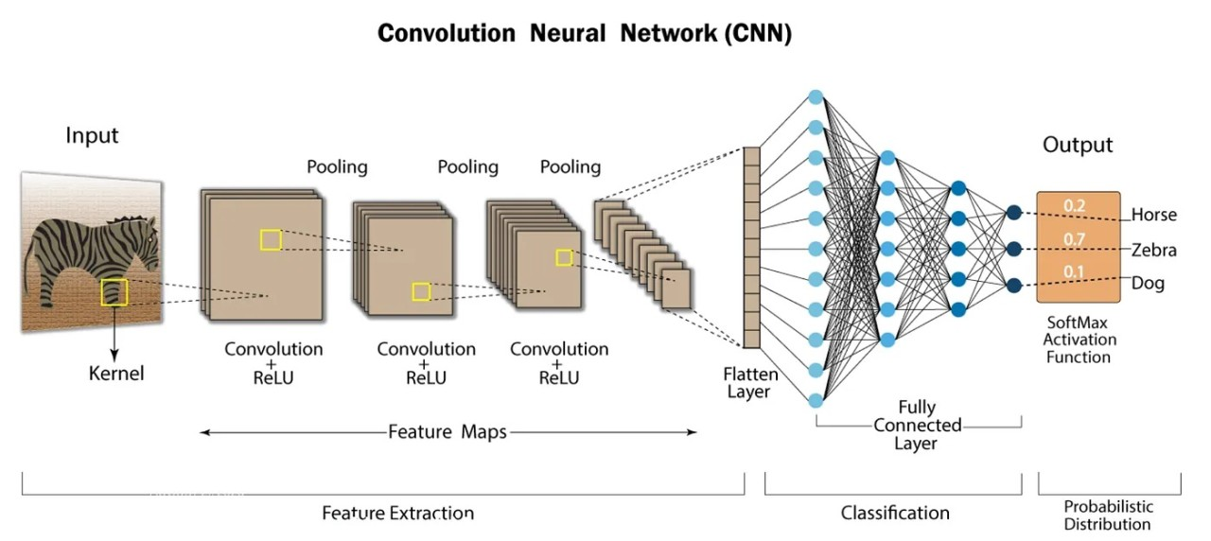
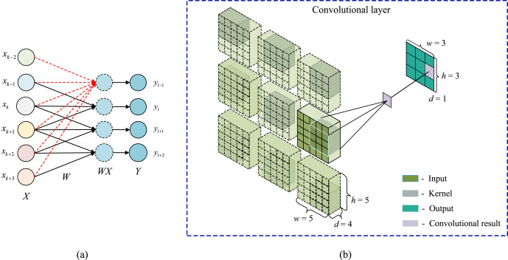
MODEL ARCHITECTURE

Slide 10
MODEL ARCHITECTURE
TRAINING DETAILS
SETUP: TRAINING PERFORMED USING PYTORCH IN GOOGLE COLAB, WITH HARDWARE ACCELERATION.
HYPERPARAMETERS: LEARNING RATE, BATCH SIZE, AND NUMBER OF EPOCHS WERE OPTIMIZED.
OPTIMIZATION: USED STOCHASTIC GRADIENT DESCENT (SGD) OPTIMIZER WITH MOMENTUM AND LEARNING RATE SCHEDULER.
PERFORMANCE RESULTS
TRAINING AND VALIDATION LOSS/ACCURACY PLOTS SHOWING THE MODEL'S PERFORMANCE OVER EPOCHS.
CONFUSION MATRIX ILLUSTRATING THE CLASSIFICATION RESULTS.
PERFORMANCE COMPARISON BETWEEN CNN AND ANN MODELS.

Slide 11
MODEL ARCHITECTURE
HYPERPARAMETER SEARCH
DEFINE HYPERPARAMETER SPACE: THE CODE DEFINES A SEARCH SPACE FOR LEARNING RATES ([1E-3, 1E-4, 1E-5]) AND BATCH SIZES ([4, 8, 16]).
TRAIN AND EVALUATE MODELS: FOR EACH COMBINATION OF LEARNING RATE AND BATCH SIZE, A NEW CNN MODEL IS TRAINED FOR 25 EPOCHS USING ADAM OPTIMIZER AND CROSS-ENTROPY LOSS. THE MODEL'S PERFORMANCE IS EVALUATED ON THE TEST SET AFTER TRAINING.
SELECT BEST HYPERPARAMETERS: THE BEST HYPERPARAMETERS ARE IDENTIFIED BASED ON THE ACCURACY ACHIEVED ON THE TEST SET, AND THE PARAMETERS WITH THE HIGHEST ACCURACY ARE SAVED AS THE BEST.
MODEL FINE-TUNING
MODIFIED CNN ARCHITECTURE: THE CNN MODEL IS REFINED TO INCLUDE THREE CONVOLUTIONAL LAYERS WITH BATCH NORMALIZATION, RELU ACTIVATION, AND MAX-POOLING, FOLLOWED BY TWO FULLY CONNECTED LAYERS WITH DROPOUT FOR REGULARIZATION.
USING SGD OPTIMIZER: THE FINE-TUNED CNN MODEL IS TRAINED USING STOCHASTIC GRADIENT DESCENT (SGD) OPTIMIZER WITH THE BEST LEARNING RATE IDENTIFIED FROM HYPERPARAMETER SEARCH AND MOMENTUM OF 0.9.
LEARNING RATE SCHEDULER: A STEP LEARNING RATE SCHEDULER IS IMPLEMENTED TO ADJUST THE LEARNING RATE EVERY 10 EPOCHS BY A FACTOR OF 0.1 TO IMPROVE THE TRAINING PROCESS AND MODEL PERFORMANCE.

Slide 12
MODEL FINE-TUNING

Slide 13
MODEL FINE-TUNING
MODIFIED CNN ARCHITECTURE
Convolutional Layers: Three convolutional layers are used, each followed by Batch Normalization and ReLU activation to stabilize and enhance the learning process.
Pooling Layers: Max-Pooling layers are added to reduce the spatial dimensions, which helps in reducing the number of parameters and computation in the network.
Fully Connected Layers: Two fully connected layers are included with a dropout layer in between to prevent overfitting. The dropout layer randomly drops a fraction of neurons during training, which helps the model become more robust.

Slide 14
MODEL FINE-TUNING
USING SGD OPTIMIZER
THE MODEL IS TRAINED USING THE STOCHASTIC GRADIENT DESCENT (SGD) OPTIMIZER INSTEAD OF THE ADAM OPTIMIZER USED EARLIER.
SGD WITH MOMENTUM: THE OPTIMIZER USES A LEARNING RATE (FROM THE BEST PARAMETERS FOUND DURING HYPERPARAMETER SEARCH) AND MOMENTUM OF 0.9. MOMENTUM HELPS ACCELERATE THE GRADIENT VECTORS IN THE RIGHT DIRECTIONS, THUS LEADING TO FASTER CONVERGENCE.
LEARNING RATE: THE LEARNING RATE IS A CRUCIAL HYPERPARAMETER THAT CONTROLS HOW MUCH TO CHANGE THE MODEL IN RESPONSE TO THE ESTIMATED ERROR EACH TIME THE MODEL WEIGHTS ARE UPDATED.

Slide 15
MODEL FINE-TUNING
IMPLEMENTING LEARNING RATE SCHEDULER
A STEP LEARNING RATE SCHEDULER IS IMPLEMENTED TO DYNAMICALLY ADJUST THE LEARNING RATE DURING TRAINING.
SCHEDULER FUNCTION: THE LEARNING RATE IS REDUCED BY A FACTOR OF 0.1 EVERY 10 EPOCHS. THIS HELPS IN FINE-TUNING THE LEARNING PROCESS BY ALLOWING THE MODEL TO MAKE LARGER UPDATES INITIALLY AND THEN FINE-TUNE THE WEIGHTS WITH SMALLER UPDATES AS IT GETS CLOSER TO THE OPTIMAL SOLUTION.
BENEFITS: THIS APPROACH HELPS IN PREVENTING THE MODEL FROM OVERSHOOTING THE MINIMA OF THE LOSS FUNCTION AND HELPS IN ACHIEVING BETTER CONVERGENCE.

Slide 16


INSIGHTS AND LEARNINGS

Slide 17
INSIGHTS AND LEARNINGS
DATA ORGANIZATION AND PREPROCESSING
STRUCTURED DATA: THE DATASET IS ORGANIZED INTO TRAIN AND TEST FOLDERS WITH EACH FOLDER CONTAINING IMAGES REPRESENTING 15 DIFFERENT HUMAN ACTIVITIES. PROPER ORGANIZATION FACILITATES EFFICIENT DATA LOADING AND PREPROCESSING.
DATA AUGMENTATION: DATA AUGMENTATION TECHNIQUES SUCH AS RANDOM FLIPS, ROTATIONS, AND CROPS ARE UTILIZED TO INCREASE THE DIVERSITY OF TRAINING DATA, WHICH HELPS IN IMPROVING THE MODEL'S GENERALIZATION CAPABILITY.

Slide 18
INSIGHTS AND LEARNINGS
MODEL ARCHITECTURE AND TRAINING
CONVOLUTIONAL NEURAL NETWORK (CNN): THE BASE MODEL ARCHITECTURE CONSISTS OF MULTIPLE CONVOLUTIONAL LAYERS FOLLOWED BY POOLING LAYERS, WHICH ARE EFFECTIVE IN EXTRACTING SPATIAL FEATURES FROM IMAGES.
BATCH NORMALIZATION AND DROPOUT: INCORPORATING BATCH NORMALIZATION LAYERS STABILIZES THE TRAINING PROCESS, WHILE DROPOUT LAYERS HELP IN REDUCING OVERFITTING BY RANDOMLY DROPPING NEURONS DURING TRAINING.

Slide 19
INSIGHTS AND LEARNINGS
HYPERPARAMETER TUNING
LEARNING RATE AND BATCH SIZE: SYSTEMATICALLY TUNING THE LEARNING RATE AND BATCH SIZE IS CRUCIAL FOR ACHIEVING OPTIMAL PERFORMANCE. EXPERIMENTATION WITH DIFFERENT VALUES HELPS IN FINDING THE BEST COMBINATION THAT MAXIMIZES ACCURACY.
OPTIMIZER SELECTION: TESTING DIFFERENT OPTIMIZERS (E.G., ADAM, SGD WITH MOMENTUM) PROVIDES INSIGHT INTO WHICH OPTIMIZER WORKS BEST FOR THE GIVEN TASK. SGD WITH MOMENTUM WAS FOUND TO IMPROVE TRAINING STABILITY AND SPEED.

Slide 20
INSIGHTS AND LEARNINGS
EVALUATION AND METRICS
ACCURACY AND LOSS: MONITORING ACCURACY AND LOSS METRICS DURING TRAINING AND VALIDATION PHASES HELPS IN UNDERSTANDING THE MODEL'S PERFORMANCE AND IDENTIFYING OVERFITTING OR UNDERFITTING ISSUES.
CONFUSION MATRIX: ANALYZING THE CONFUSION MATRIX PROVIDES DETAILED INSIGHT INTO WHICH CLASSES ARE BEING MISCLASSIFIED, ALLOWING FOR TARGETED IMPROVEMENTS IN THE MODEL.

Slide 21
INSIGHTS AND LEARNINGS
LEARNING RATE SCHEDULER
DYNAMIC ADJUSTMENT: IMPLEMENTING A LEARNING RATE SCHEDULER THAT REDUCES THE LEARNING RATE AFTER A SET NUMBER OF EPOCHS HELPS IN MAKING MORE REFINED UPDATES TO THE MODEL PARAMETERS, IMPROVING CONVERGENCE AND PERFORMANCE.

Slide 22
KEY TAKEAWAYS
ORGANIZED DATA STRUCTURE AND EFFECTIVE PREPROCESSING ARE FUNDAMENTAL FOR BUILDING A SUCCESSFUL IMAGE CLASSIFICATION MODEL.
MODEL ARCHITECTURE ADJUSTMENTS AND REGULARIZATION TECHNIQUES PLAY A CRUCIAL ROLE IN ENHANCING MODEL PERFORMANCE AND GENERALIZATION.
HYPERPARAMETER TUNING AND OPTIMIZER SELECTION ARE VITAL FOR ACHIEVING HIGH ACCURACY AND STABLE TRAINING.
EVALUATION METRICS AND CONFUSION MATRIX ANALYSIS PROVIDE INSIGHTFUL FEEDBACK FOR MODEL IMPROVEMENTS.
LEARNING RATE SCHEDULERS AND FINE-TUNING STRATEGIES CONTRIBUTE TO BETTER MODEL CONVERGENCE AND OVERALL PERFORMANCE.

Slide 23

REFERENCE
https://medium.com/bitgrit-data-science-publication/building-an-image-classification-model-with-pytorch-from-scratch-f10452073212
https://www.kaggle.com/code/arnoldyanga/image-classification-using-pytorch
https://medium.com/thecyphy/train-cnn-model-with-pytorch-21dafb918f48
https://towardsdatascience.com/pytorch-vision-multiclass-image-classification-531025193aa
https://pytorch.org/tutorials/beginner/blitz/cifar10_tutorial.html

Slide 24

Thank you
DHRUV JOSHI
1216650
D_FANSHAWEONLINE.CA
GITHUB.COM

